Slide 1
Welcome

Slide 2
Predict House Sales Prices Advanced Regression Techniques
By
Baskaran Viswanathan

Slide 3
Problem Statement
How to give a price range to home buyer, by predicting the price, based on the different features of a house, including no of bedrooms, size of the living area, etc.…

Slide 4
Dataset Source
https://www.kaggle.com/c/house-prices-advanced-regression-techniques/data
Dataset Details
The data has 79 explanatory variables describing (almost) every aspect of residential homes in Ames, Iowa, USA.
Records details
Total No of Rows: 1460
Total No of Columns: 80

Slide 5
Data Description
SalePrice
The property's sale price in dollars. This is the target variable
The remaining data are related to other properties of a normal house like
No of bedrooms
No of garage
The previous slide link has all other properties details

Slide 6
Initial findings
Total No of Quantitative Features: 37
Total No of Qualitative Features: 39
The Sale price distribution details are
Min Selling Price is: 34900
Average Selling Price is: 180921.20
Median Selling Price is: 163000.0
Max Selling Price is: 755000

Slide 7
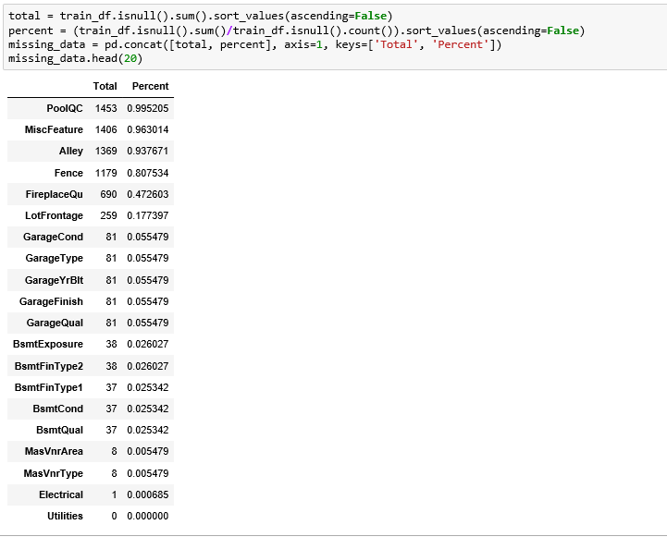
Missing Data Analysis

Slide 8
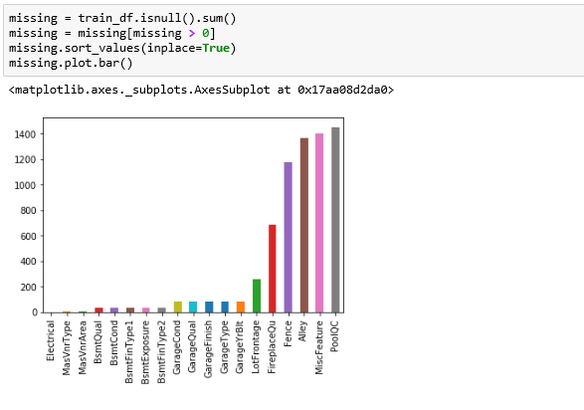
Missing Data Analysis

Slide 9
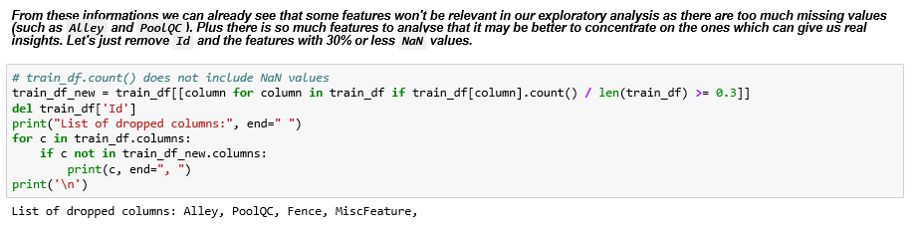
Missing Data Analysis

Slide 10
Relationships Significant
Feature Name | Percentage of Relationships Significant
MSSubClass | 97.70%
GarageType | 93.00%
Neighborhood | 90.70%
ExterQual | 90.70%
BldgType | 90.70%
Exterior2nd | 90.70%
BsmtQual | 88.40%
Exterior1st | 88.40%
KitchenQual | 88.40%
HouseStyle | 88.40%
BsmtFinType1 | 86.00%
BsmtExposure | 86.00%
MSZoning | 83.70%
Foundation | 83.70%
BsmtFinType2 | 83.70%
FireplaceQu | 81.40%
GarageCond | 81.40%
GarageFinish | 81.40%
PavedDrive | 81.40%
SaleCondition | 81.40%

Slide 11
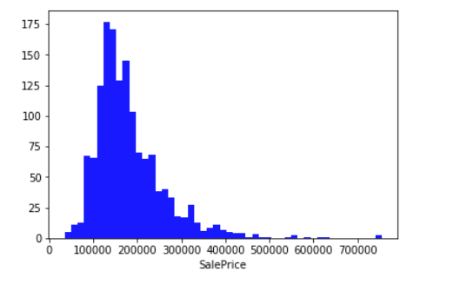
Sale Price Distribution
With this information we can see that the prices are skewed right and some outliers lies above ~500,000.

Slide 12
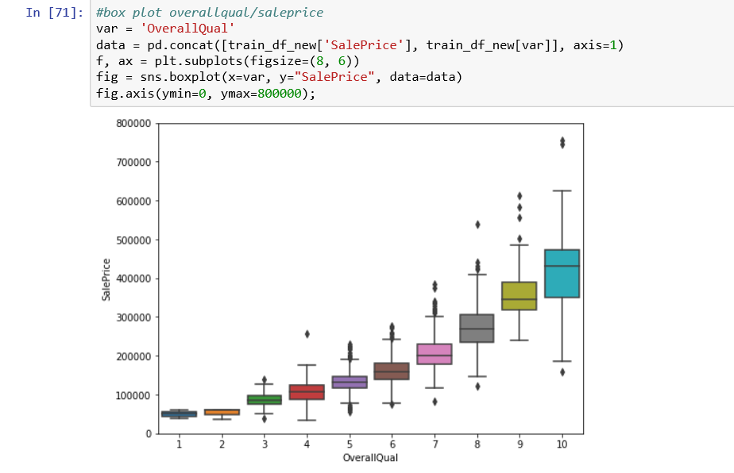
Overall Qualification Vs SalePrice
The OverallQualification Vs SalePrice shows that the Price ranges are from $350000 to $450000.

Slide 13
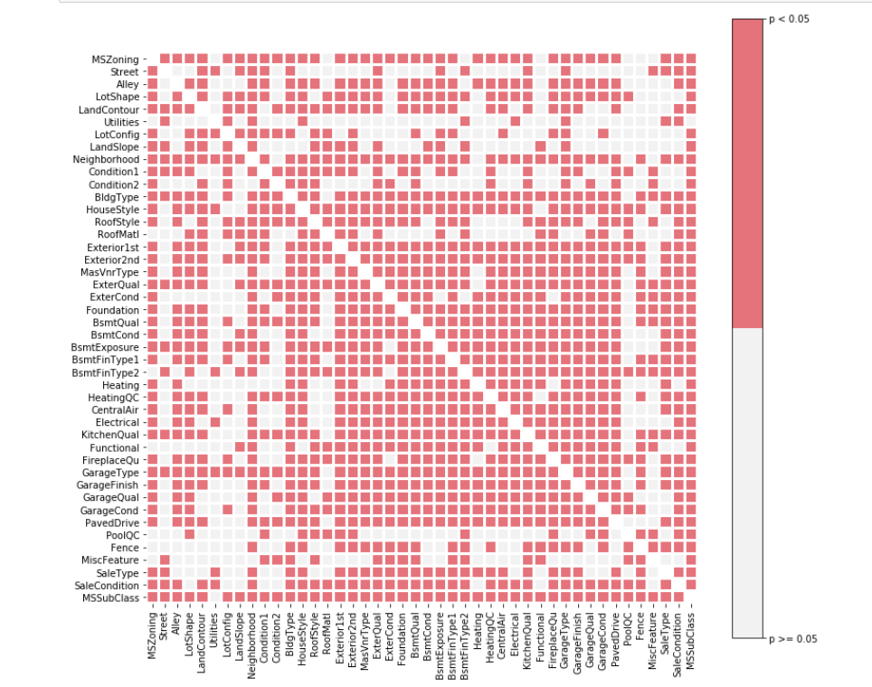
Statistically Significant vs Non-significant

Slide 14
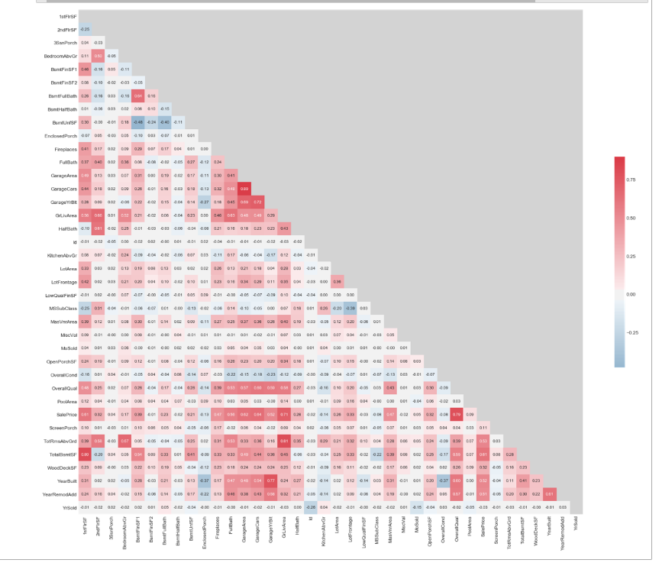
Correlation Matrix - Pearson coefficients

Slide 15
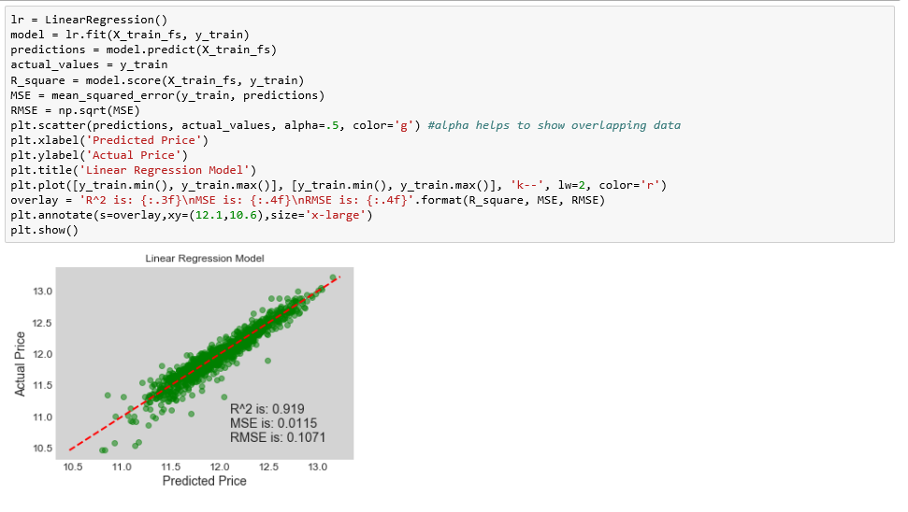
Linear Regression

Slide 16
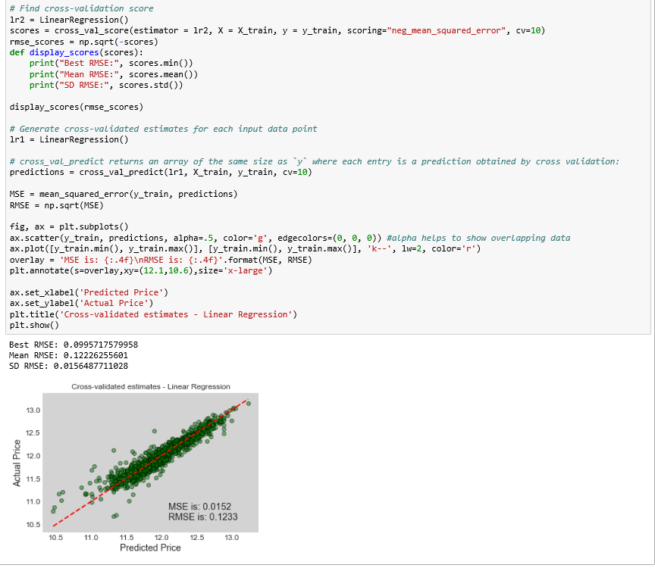
Cross Validation - Linear Regression

Slide 17
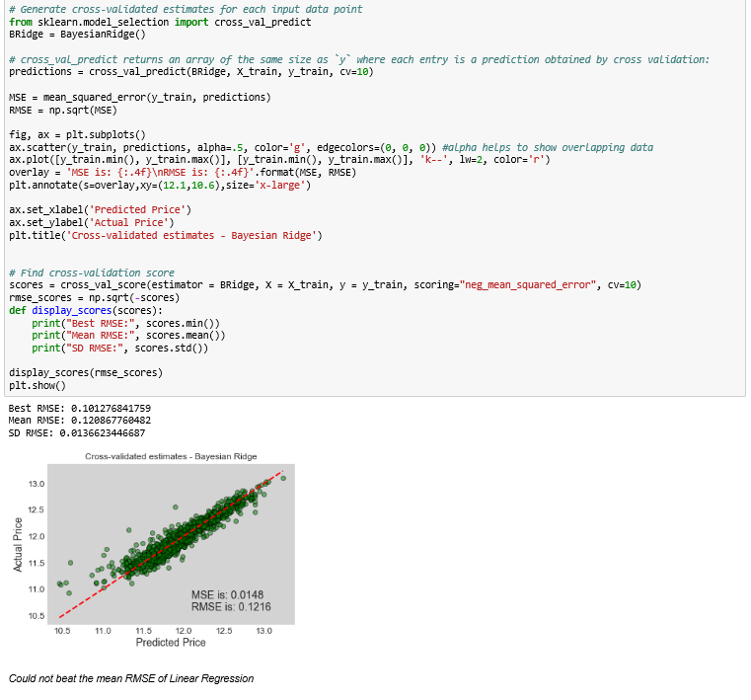
Cross Validation – LR (Bayesian Ridge)

Slide 18
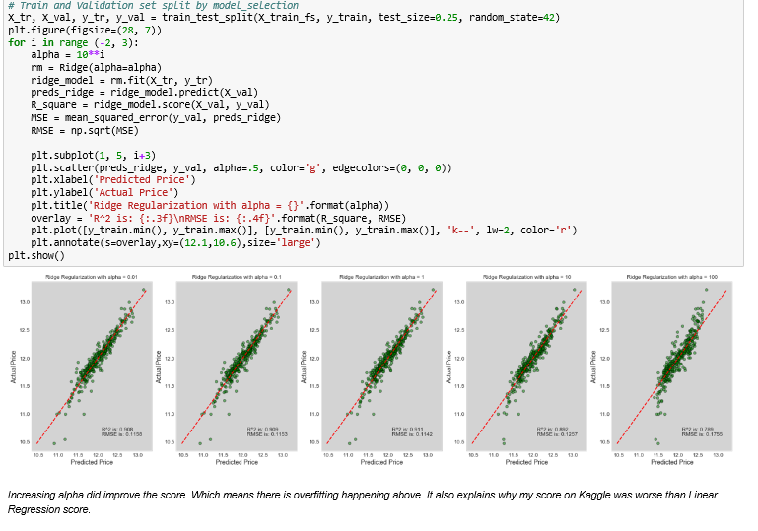
Ridge Regression

Slide 19
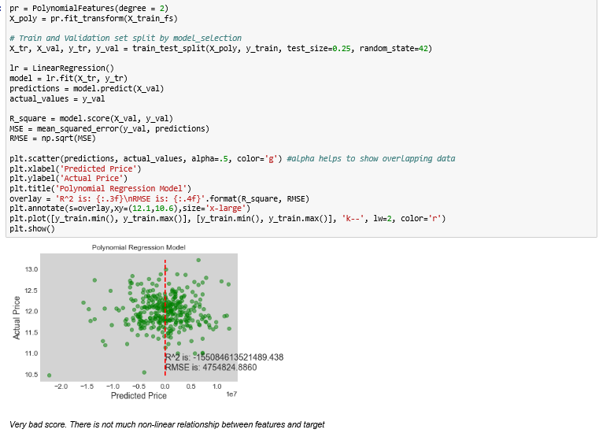
Polynomial Regression

Slide 20
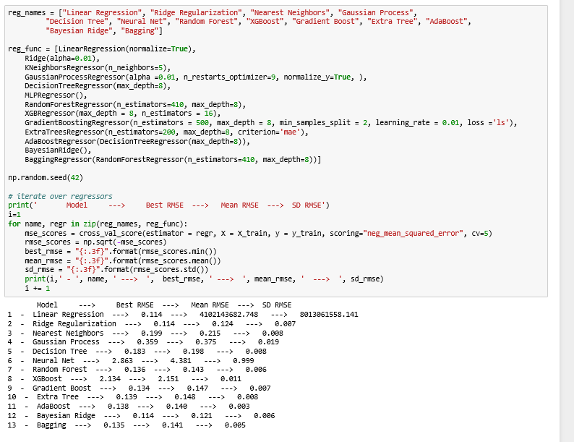
Regression Comparison - Plain

Slide 21
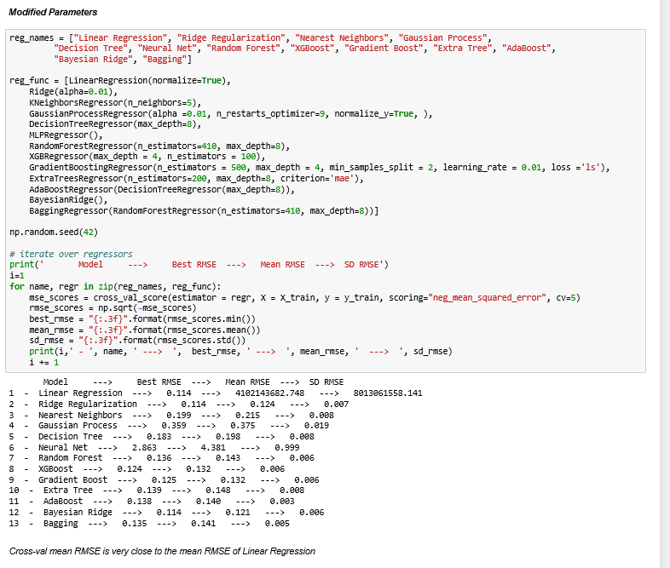
Regression Comparison – Tuned Param

Slide 22
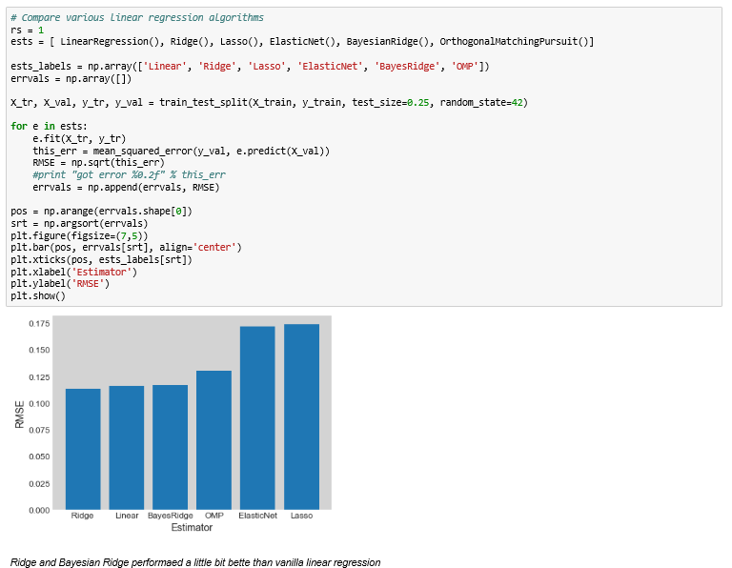
Regression Comparison

Slide 23
Final Thoughts - Data
All the data in the dataset are not having complete data for all the observations
15 % of properties are having missing values
Data is not normally distributed
Neighborhood has big impact on house prices. Most expensive seems to be Partial SaleCondition. Having pool on property seems to improve price substantially

Slide 24
RMSE(Root Mean Square Error)
Cross Validation - Linear Regression
Best RMSE: 0.0995
Cross Validation - Linear Regression (Bayesian Ridge)
Best RMSE: 0.1012
Ridge Regression or Tikhonov regularization
Best RMSE: 0.1153
Polynomial Regression
Best RMSE: 4754824.8860 – Very Bad

Slide 25
RMSE - Comparison
Model | Best RMSE
Linear Regression | 0.114
Ridge Regularization | 0.114
Nearest Neighbors | 0.199
Gaussian Process | 0.359
Decision Tree | 0.183
Neural Net | 2.863
Random Forest | 0.136
XGBoost | 2.134
Gradient Boost | 0.134
Extra Tree | 0.139
AdaBoost | 0.138
Bayesian Ridge | 0.114
Bagging | 0.135
Normal Regression is doing better than the others

Slide 26
Thank you

